Slide 1
Unit 2
Derived Data Types
Pointers
PDEU
Notes:
Institute of Petroleum Technology, Gandhinagar
By Darshit Shah

Slide 2
Memory State
Let us declare one variable
int x = 50;
The memory representation will be
x
variable
50
value
Address of x
65524

Slide 3
Accessing Address of a Variable
int x = 50;
int * xptr; //← xptr is an integer pointer.
xptr = & x; // assigning address of x to xptr.
printf(“%d”,x); // value of x.
printf(“%u”, xptr); // value of xptr (Unsigned).
printf(“%d”, *xptr); // value of x via pointer.
x
variable
xptr
50
value
65524
65524
Address
65522

Slide 4
Accessing Address of a Variable
int **yptr = & xptr;
printf(“%u”, yptr); // 65522
printf(“%u”, *yptr); // 65524
printf(“%u”, &yptr); // 65520
printf(“%d”, **yptr); // 50
x
xptr
yptr
50
65524
65522
65524
65522
65520

Slide 5
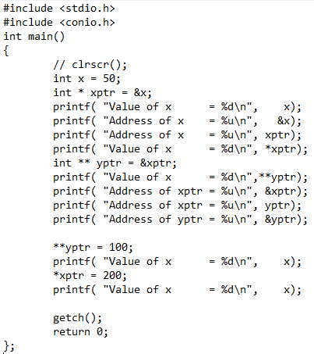
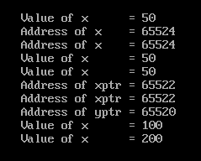
Understand the concept

Slide 6
Different Operations on a Pointer
Addition of an integer number to a pointer.
e.g.
int i = 5, *j , *k;
j = &i;
j++; j += 4;
k = j + 5;

Slide 7
Explanation
Formula: Address of Variable + (sizeof (data-type) * integer number)
Suppose, address of i = 1000, address of j = 998 and address of k = 996, then
j = &i; → j = 1000
j++; → j = j + 1; → 1000 +(2 *1) = 1002
j += 4;→j = j + 4 → 1002 +(2*4) = 1010
k = j + 5; → 1010 + (2*5) = 1020

Slide 8
Different Operations on a Pointer
Subtraction of a number from a pointer.
e.g.
int i = 5, *j , *k;
j = &i;
j - - ; j - = 4;
k = j - 5;

Slide 9
Different Operations on a Pointer
Subtraction of one pointer from another pointer.
e.g.
int arr [ ] = { 10,20,30,40};
int * i, * j ;
i = &arr [ 1 ]; j = &arr [ 3 ];
printf(“%u”, j – i) ; // 2
printf(“%d”, *j - *i); // 20
arr
10
i
20
30
j
40
Notes:
i and j will be pointing to values 20 and 40 respectively after the execution of 3rd line.
Institute of Petroleum Technology, Gandhinagar
By Darshit Shah

Slide 10
Different Operations on a Pointer
Comparison of two pointer variables.
They should be of same type.
e.g.
int arr [ ] = {10,20,30,40};
int * i, * j ;
i = &arr [ 1 ]; j = (arr + 1 );
printf(“%s”, ((i == j)?"Eq.":"! Eq.“));

Slide 11
Pointers & Arrays
In C, there is a strong relationship between pointers and arrays.
int a[10]; ← defines an array of 10 integers in the memory and stores the starting address in variable a.

Slide 12
Pointers & Arrays
int a[10];
int * p; ⬅ declare a pointer to an integer. This variable p can point to any integer variable.
p = a; ← p will point to an array a.
Address of a will be stored as value of p.

Slide 13
Pointers & Arrays
int a[10];
int * p;
p = a;
Remember that now we can’t change the value of a but we can definitely change the value of p.
So, now, using pointer p, we will accept different values in array a and print them later on.

Slide 14
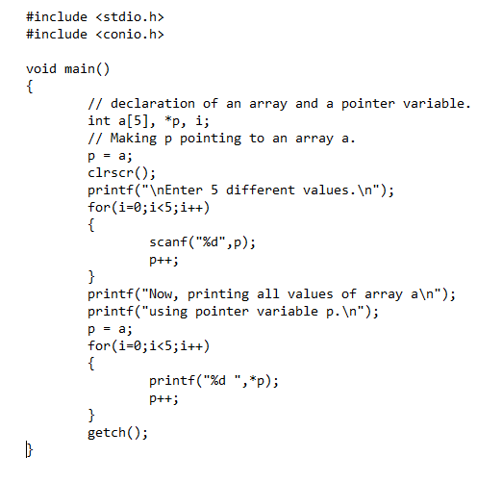

Pointers & Arrays

Slide 15
Pointers & Arrays
int a[10];
int * p = a; ← declaring a pointer variable and making it point to an array.
We can now reference members of the array using either a or p.
  printf(“%d”,p[0]);
  p[2] = a[3];
  int x = p[0] * a[4] + 5;

Slide 16
Pointers & Arrays
The name of an array is equivalent to a pointer to the first element of the array and vice-versa.
Therefore, if a is the name of an array, the expression
a[i] is equivalent to *(a + i).
It follows then that &a[i] and (a + i) are also equivalent. Both represent the address of the i-th element beyond a.
On the other hand, if p is a pointer, then it may be used with a subscript as if it were the name of an array.
p[i] is identical to *(p + i)
In short, an array-and-index expression is equivalent to a pointer-and-offset expression and vice-versa.

Slide 17
Strings revisited
Recall that a string is represented as an array of characters terminated with a null (\0) character.
A string constant may be declared as either
char[ ] or char *
as in
char name[ ] = "PDEU";
or (almost) equivalently
char *name = "PDEU";
A typedef could also be used to simplify coding
typedef char* STRING;
STRING name = "PDEU";

Slide 18
Arrays of Pointers
Since a pointer is a variable type, we can create an array of pointers just like we can create any array of any other type.
Although the pointers may point to any type, the most common use of an array of pointers is an array of char* to create an array of strings.

Slide 19
Storing names using array of pointers
A common use of an array of pointers is to create an array of strings.
char *name[] = { "FoET", "SoT", "SPT” };
The above declaration creates and initializes an array of strings (char *) for some names. The diagram below illustrates the memory configuration.

Slide 20
Storing names using array of pointers
char *names[] = { "FoET", "SoT", "SPT” };
The diagram below illustrates the memory configuration.
names
0
F
o
E
T
\0
1
S
o
T
\0
2
S
P
T
\0

Slide 21
Types of Pointer
Integer Pointers: int *ptr;
Array Pointer or pointer to array: char *ptr = &array_name;
Double Pointers or pointer to pointer: datatype ** pointer_name;
Structure Pointer: struct struct_name *ptr;
Function Pointer: int (*ptr)(int, char);
Void Pointer: void * pointer_name;
Constant Pointer: data_type * const pointer_name;
Pointer to Constant: The pointers pointing to a constant value that can't be
modified: const data_type * pointer_name;
Dangling pointer: A pointer pointing to a memory location that has been deleted (or freed) is called a dangling pointer.

Slide 22
Why are Pointers Used ?
To return more than one value from a function.
To pass arrays & strings more conveniently from one function to another.
To allocate memory and access it (Dynamic Memory Allocation).
To create complex data structures such as Linked List, Where one data structure must contain references to other data structures.
More on these later on…

Slide 23
!!!!! Words of Caution !!!!!
Do not attempt
Addition of two pointers.
Multiplication of a pointer with a constant.
Division of a pointer with a constant.

Slide 24
What We Learnt…
& operator gives address of the variable.
* operator gives value at the address of the variable (De-referencing).
We can add an integer constant to a pointer.
We can subtract number from a pointer.
We can subtract one pointer from another pointer.
We can compare two pointers.

Slide 25
What We Learnt…
Pointers and Arrays
  int a[10];
  int * p;
  p = a; or p = &a[0]; or int *p = a;
Revisited Strings
  char name[ ] = "PDEU";
  typedef char * STRING; STRING name = "PDEU";
Arrays of Pointers
  char * names[ ] = { "FoET", "SoT","SPT"};

Slide 26
What We Learnt…
but don't try:
add two pointers.
multiply a pointer with a constant.
Divide a pointer with a constant.

Slide 27
int arr [ ] = { 10, 20, 30, 40 };
There are 4 values in the array so compiler will allocate 8 contiguous bytes and starting address of these 8 bytes will be stored in variable arr.
arr
1000
10 | 20 | 30 | 40
1000 | 1002 | 1004 | 1006
Address

